Slide 1
Video Industry Solutions
Notes:
Apart from the Gaming industry, Media technology is another area where we are investing a lot in R&D.

Slide 2
Objectives
After completing this course, you will be able to:
Understand the industrial characteristics of live streaming, video on demand (VOD), and real-time communication (RTC) services in the video industry
Master the scheme design of live streaming architecture
Master the scheme design of VOD architecture
Master the scheme design of RTC architecture
Understand video industry solutions through case study
Notes:
This chapter introduces the solutions of Tencent Cloud in the video industry. The main content covers:
Overview of the characteristics of the video industry
Understand architecture for Video solutions.
And many Use Cases of video solutions
There are mainly 3 solutions we will talk about here

Slide 3
Section 1. Overview of Video Industry
Section 2. Scheme Design of Live Streaming Scenario
CONTENTS
Section 3. Scheme Design of VOD Scenario
Section 4. Scheme Design of RTC Scenario
Section 5. Video Industry Case Study

Slide 4
Section 1. Overview of Video Industry
CONTENTS
1.1 Video industry scenario classification
1.2 Challenges faced by video industry
1.3 Tencent Cloud solutions for video industry

Slide 5
1.1 Video Industry - Classification
Live Broadcast (LVB)
On Demand (VOD)
Real-Time Communication (RTC)
Notes:
The video industry can be divided into the three categories：based on whether the video is (Live or Recorded) and whether it is a (1-way VS 2-way communication).
Live Broadcast: is a live video and 1-way communication; show/event live broadcast, live commerce;
Real-time Communication: is a live and 2-way communication; video conference, video customer service, tele-health
On-Demand: where the video is recorded in advance, and video will be replayed on demand as needed;
UGSV

Slide 6
Glossary
Video Codec
•MPEG
•H.264 / H.265
•VP8 / VP9
Bitrate: number of bits that are required in playback (bps)
Adaptive bitrate: streaming involves audio/video files with various bitrates. A player can dynamically select the most appropriate bitrate for playback based on the current bandwidth (HLS, MPEG-DASH, Microsoft Smooth Streaming MSS)
Transcoding: changes the codec, resolution, bitrate, and other parameters of the bitstream for playback on different devices in various network environments.
Protocols
RTMP (Realtime Messaging Protocol): a streaming protocol developed by Adobe (limited to Flash Player, no longer accepted by iOS, Android, and most browsers)
FLV: a protocol developed by Adobe, supported by Flash player on PCs. Most mobile browsers do not support FLV
HLS (HTTP Live Streaming): a protocol developed by Apple, supported iOS + Android clients.
DRM: Digital Rights Management

Slide 7
Typical Video Workflow

Slide 8
1.2 Challenges faced by video industry
Traditional live streaming vs. Tencent Cloud Streaming Services (CSS) (a.k.a LVB)
High costs
Slow service release
Required monitoring the underlying systems
Required OPS
Required Development
Traditional live streaming platform
Difficult OPS
Poor performance
…….
The CSS platform is the answer
Low costs
OPS-free operations
No need to care about the underlying systems
No need to care about OPS
Less focus on development
More focus on business
Tencent CSS platform
Complete features
Security
…….
Fast release
Notes:
Think about how you would build a live broadcast application:
High cost: You have to build underlying IT infrastructure, you need to have space, networks, storage, servers, etc.; IT infrastructure needs to be manually managed, and the costs of operation and maintenance;
Slow Launch: and it will take times to build these systems
Poor performance: Scalability, High-bandwidth network;
CSS PaaS：
Low cost: No infrastructure
Our LVB combines the CDN service, improving the video experience;
Fast Launch: CSS platforms and SDKs for different terminal platforms; iOS and Android to speed up the application development;

Slide 9
1.2 Challenges faced by video industry (continued)
Background of emergence of the VOD solution:
Internet users' demand for video watch is only second to social networking/chatting, and audio/video services have become the major source of mobile internet traffic.
The basic atomic capabilities for building audio/video services are diversified and difficult to be integrated at one time.
The traditional scheme (CDN + COS + transcoding) has certain limitations:
The architecture of the scheme for integrating multiple services is complicated, and the costs for customer access are high.
Services such as transcoding, AI features, and video capturing cannot be provided in the cloud.
Audio/Video capturing
PaaS platform
Audio/Video playback acceleration
Audio/Video storage
Audio/Video AI and transcoding
Notes:
Now, let’s think about how you would build a VOD solution?
There are 4 basic components of VOD solution => capture/store/transcode/playback
Additionally, video access management (such as authentication, content verification, DRM etc.).
There are needs for Cloud-based VOD solution, that integrates audio and video capture/upload, storage management, automated transcoding processing, accelerated playback, and media resource management.

Slide 10
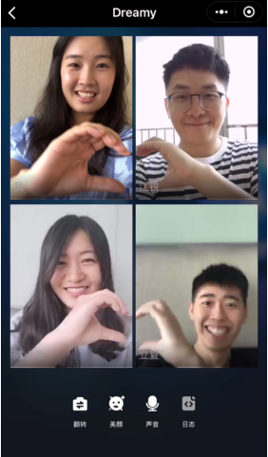
1.2 Challenges faced by video industry (continued)
Technical requirements for RTC systems:
Low latency
Smoothness
Acoustic echo cancellation (AEC)
Interconnection across countries/regions
High concurrency
Notes:
For a real-time interactive audio and video system, there are many technical requirements：
Low latency: for a real-time interaction, the one-way end-to-end delay is probably less than 400 milliseconds to ensure smooth communication;
Avoid video freezing during the call;
Echo cancellation
cross-country interconnectivity;
Capacity - how many people will join the call session.

Slide 11
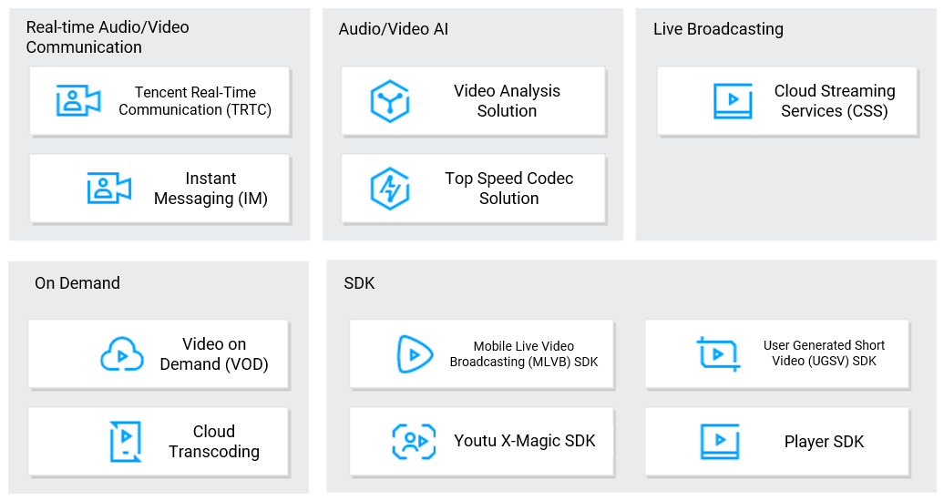
1.3 Tencent Cloud Video Solutions
Tencent Cloud Video Solutions:
Notes:
Tencent Cloud provides a one-stop video solution covering on-demand videos, live streaming, real-time video calls and short videos as well.
Live broadcast products: LVB;
On-demand products: VOD, cloud transcoding;
TRTC for real-time audio and video, IM for text communication;
Abundant SDKs: mobile live streaming SDK, player SDK, short video SDK, SDK;
Audio and video AI solutions: video analysis solutions;

Slide 12
Section 2. Scheme Design of Live Streaming Scenario
2.1 Challenges faced by live streaming scenarios
CONTENTS
2.2 Tencent Cloud live streaming solutions
Notes:
The next section, let’s go through the architecture design of each of the video solutions, starting with Live Streaming scenario.

Slide 13
2.1 Challenges faced by live streaming scenarios
Considerations in live streaming scenarios:
Video stream transcoding and distribution
Guarantee for playback quality (smooth and stable video playback, low latency, and instance broadcasting of the first frame)
Video availability monitoring
Interactive needs such as real-time on-screen commenting and chatting in live rooms
High-Performance message channel
Content control, such as algorithm-based porn detection and text filtering
Content security (hotlink protection)
Guarantee for system availability and stability
Cost control
Notes:
The good live streaming platform should include these characteristics:
Hotlink protection is the feature to set the validity period, which player can playback, and playback duration etc.
Value-added, like, DRM, Ads Management, Data Analytics

Slide 14
2.1 Challenges faced by live streaming scenarios (continued)
Design Principles for solving live streaming problems:
Ensure nearest access for users (smart scheduling and DNS)
Segment video streams for distributed storage and use CDN to distribute them and reduce the latency.
Monitor the availability of the entire live streaming linkage.
Process messages asynchronously to improve the system stability.
Use a message bucket policy to control the reach of messages/on-screen comments and reduce the pressure on message channels.
Use overload protection and service degradation policies to improve the playback smoothness.
Use AI technologies to detect pornographic information in live streams.
Use multiple methods such as encryption and watermark to protect content security and copyright.
Select an appropriate traffic billing mode to control the traffic bandwidth costs.
Notes:
It is fortunate to us PaaS, so we do not have to worry about building this, but as the architect, we should have the understandings of what challenges are, and how to address those challenges.
Using Smart Scheduling+CDN, we can：
Keep latency to minimum;
The video stream is sliced and stored on the distributed file system and distributed to the CDN, because the CDN is closest to the user, so as to ensure the low latency of the live content for the user, and the user’s Shortest path access；
Asynchronous message processing and bucketing strategy：
Asynchronous use of large clusters for parallel processing improves the throughput of the system. Asynchrony enables back-end message delivery to be free from interference from the upstream peak traffic of front-end messages, and improves system stability.
The message sent by the user is only visible in one bucket, and the user receives the message according to the bucket dimension. On the one hand, the amount of messages received by the front-end user will be much less, and The message does not need to be sent to all users, but only to one or some buckets to reduce the downward pressure of the message。
Overload protection and service degradation：
Downgrade, for example, the current live broadcast is 1080P, downgraded to 360P or 540P
Traffic Cost：
The cost of bandwidth and traffic in live broadcast scenarios is often very high. It is recommended to purchase a suitable traffic package. You can purchase a traffic package for sudden scenarios, and you can purchase annual and monthly services for daily live broadcast scenarios.

Slide 15
2.2 Tencent Cloud Live Streaming solutions
Live streaming services:
CSS:
CSS includes Live Video Broadcasting (LVB), Live Camera Broadcasting (LCB), and Live Event Broadcasting (LEB) services to provide a one-stop audio/video live streaming solution with the aid of Mobile Live Video Broadcasting (MLVB) SDK.
MLVB SDK:
As an extension of CSS in mobile scenarios, it provides high-quality live streaming services on mobile devices to quickly meet the requirements for mobile live streaming.
Notes:
CSS：
Cloud Streaming Services provides professional live broadcast processing services. Depending on the needs of different live broadcast scenarios, CSS contains 3 different services: standard, slow, and fast broadcast. It also works with MLVB SDK.
Live Event Broadcasting (LEB) is the ultra-low-latency version of LVB. It is suitable for scenarios with high requirements on latency, such as online education, sports streaming, and online quizzes. LEB uses the UDP protocol to keep the latency within 1s, much lower than 3-5s in traditional live streaming.
MLVB SDK：
MLVB SDK is an extension of CSS for mobile use case. It can be used to develop custom apps and launch end-to-end live streaming services.
MLVB is a cross-platform SDK, iOS, Android, Web Client SDK
It comes with built-in content analysis algorithms, enabling features like real-time face detection, light compensation, and beauty filters

Slide 16
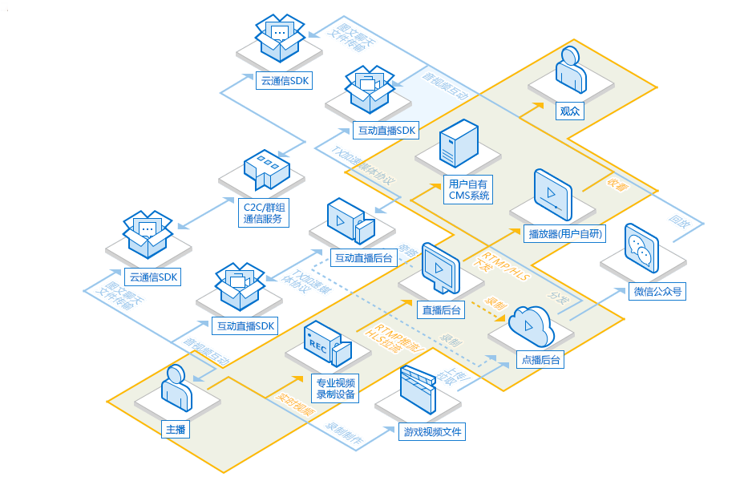
2.2 Tencent Cloud Live Streaming solutions (continued)
CSS architecture:
Transcoding
Interaction
Capturing
Playback
Host
Distribution
Recording
Screencapturing
Porn detection
Notes:
The architecture of the live broadcast can be divided into three parts: the host/source, broadcasting platform, and the audience：
First, the host uses video recording equipment as input, and then pushes to the live broadcast stream with RTMP or HLS streaming, and then sends to the CMS system or to the player.
iLVB

Slide 17
2.2 Tencent Cloud Live Streaming solutions (continued)
Simplified live streaming process:
Live streaming source
Live streaming system
Cross-platform recipient
Desktop
capturing
Live stream management
Authentication
Statistical analysis
API
Web player
Smart porn detection
Real-Time playback
Connection to VOD platform
Pull/Push
High-Speed CDN
Mobile device
Dedicated video
device
Notes:
The architecture of the live broadcast can be divided into three parts: the host/source, broadcasting platform, and the audience.
Here is a simplified process：
Source: Use desktop capture methods, such as PC cameras, mobile phone, professional video cameras to collect live source data;
Live broadcast Platform: push or pull the live source data to the LVB platform. The platform itself provides useful functions, like streaming management, authentication, statistical analysis, API interface, Smart pornography detection, or conectting with VOD platform for storage;
After the video stream is converted by the LVB platform, in order to improve the user’s viewing experience, the high-speed CDN is used to distribute the video stream to the user’s nearest node in advance. The user can watch the live broadcast on various devices, such as mobile phones, PCs, and Tablets.

Slide 18
2.2 Tencent Cloud Live Streaming solutions (continued)
How the live streaming platform works:
Live stream capturing
Live streaming backend system
Live stream playback
Host
Viewer
Video transcoding
Screen
capturing
Live recording
Playback
optimization
User's proprietary push service
Web
User's proprietary player
CLB
Playback SDK
CLB
Push SDK
Push optimization
Network optimization
Network optimization
CDN
CDN
Massive
Secure
Stable
Distributed push nodes
Distributed storage cluster
Distributed playback nodes
Notes:
Platform architecture description：
The host pushes the live stream to the Tencent Cloud live broadcast source station through the Tencent Cloud uplink acceleration node on the streaming end (such as mobile phone streaming, PC streaming, and other video shooting and streaming devices).
Viewers can use the Tencent Cloud’s Player SDK to watch low-latency live streams.
Live programs can be recorded on demand and stored for video on-demand review

Slide 19
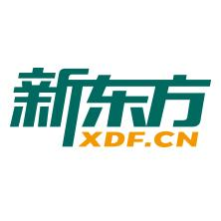
2.2 Tencent Cloud Live Streaming solutions (continued)
Main customer groups for live streaming:
Entertainment
live streaming
Ecommerce
live streaming
Radio and TV
live streaming
Surveillance
live streaming
······
Education live streaming
Corporate training
Notes:
The main customers in various business：
Entertainment Industry
E-commerce live sale
Radio and TV Live
Education Live
Corporate Training Live
Live monitoring

Slide 20
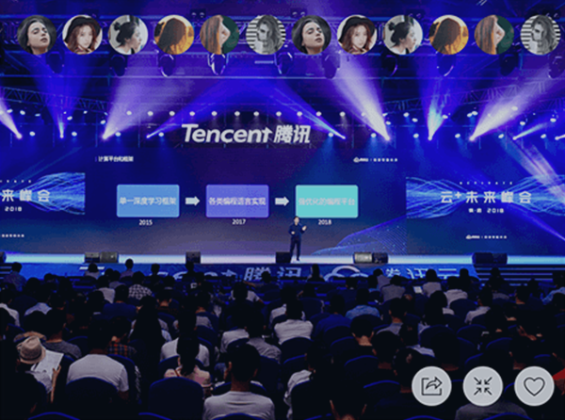
2.2 Tencent Cloud Live Streaming solutions (continued)
Live streaming scenario 1:
Press conference:
Core requirements:
Support for tens of millions of concurrent viewers
Anti-network jitter and low latency
Interactive features
Live push/HMTL5 watch
Relevant services:
CSS, MLVB SDK, and commercial live streaming solution
Press conference
Notes:
Results：
It can support millions of concurrent live streaming and making use of massive coverage of CDN nodes;
Low Latency: End-to-end delay is less than 400ms, anti-packet loss rate exceeds 30%, and anti-network jitter (800ms);
Interactive function: support text interaction;

Slide 21
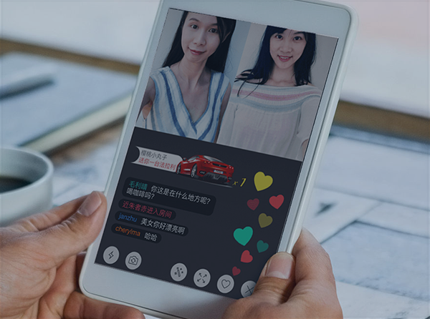
2.2 Tencent Cloud Live Streaming solutions (continued)
Live streaming scenario 2:
Show live streaming:
Core requirements:
Features such as animated effect, like, and interaction
Live streaming in multiple rooms
Relevant services:
CSS and MLVB SDK
Show live streaming
Notes:
Requirements：
Interactive functions such as floating star likes: animated effect, Like button, microphone, identity authentication.
Multi-room live broadcast: the delay is less than 500ms, viewers can watch seamlessly without switching the stream address

Slide 22
2.2 Tencent Cloud Live Streaming solutions (continued)
Live streaming scenario 3:
Education and training: TRTC, CSS, and VOD
One-to-One online education
Personalized tutoring
Immersive interactive experience
Small class:
Social networking-style online education
Engaging teaching methods
One-to-One online education
Small class
Notes:
Core needs of 1v1 online education：
Supports high-definition real-time video calls, echo cancellation.
Supports interactive whiteboard, IM, screen sharing。
Small class quality class：
Supports multiple-person audio and video interaction.

Slide 23
2.2 Tencent Cloud Live Streaming solutions (continued)
Live streaming scenario 3:
Big open class:
Support for millions of concurrent viewers
Ultra-Low latency
Video-based Q&A
Training in enterprises
Interconnection between all platforms
Ultra-Low latency
Strong anti-network jitter capability
Big open class
Corporate training
Notes:
大型公开课：
百万级并发支持：可支持千万并发直播收看，海量CDN节点全方位覆盖。
超低延时：端到端延时小于400ms，抗丢包率超过30%，抗800ms的网络抖动。
视频答疑：支持师生白板互动，支持图片、文字、语音、小视频等。
企业培训：
It can be accessed through the mobile phone or mini program for meetings or training.
The latency is less than 400ms with smooth communication.
Anti-network jitter:

Slide 24
Section 3. Scheme Design of VOD Scenario
3.1 Challenges faced by VOD scenarios
CONTENTS
3.2 Tencent Cloud VOD solutions

Slide 25
3.1 Challenges faced by VOD scenarios
Challenges faced by VOD scenarios:
How do we improve the audio/video transcoding speed?
How do we ensure highly reliable storage for high numbers of audio/video files?
How do we accelerate the distribution of users' VOD content?
How do we solve the delays in starting audio/video on demand?
How do we ensure the audio/video playback smoothness?
How do we deal with scenarios with high numbers of concurrent streams?
How do we protect the copyright of audio/video files and prevent hotlink?

Slide 26
3.2 Tencent Cloud VOD solutions
VOD-related services:
VOD:
It is a one-stop audio/video VOD solution that integrates audio/video upload, live recording, media resource management, automated transcoding, video AI, content delivery acceleration, and player SDK.
UGSV SDK:
It not only provides client SDKs that feature capturing, editing, splicing, special effect creating, sharing, and playback of audio and video clips, but also integrates Tencent's IM, social networking, and user profile data as well as cutting-edge AI-based face recognition and image detection technologies, allowing you to focus on your core business and implement your mobile UGSV application with speed and ease.
Beauty filter and special effect SDK:
It provides a wide variety of real-time special effects such as filters, beauty filters, stickers, and gesture recognition to add fun to video capturing and meet your diversified video capturing needs.
Notes:
VOD：
A one-stop audio and video on-demand solution integrating audio and video upload, live recording, media resource management, automated transcoding processing, video AI, distribution acceleration, and player SDK。
短视频SDK：
Based on Tencent Cloud's powerful upload, storage, transcoding, and distribution cloud on-demand capabilities, it provides a client SDK that integrates collection, editing, splicing, special effects, sharing, and playback functions, and integrates Tencent's IM, social, and user portrait data And the top AI face recognition and image detection technology to help users focus on the business itself and quickly and easily implement short video applications based on mobile terminals。
美颜特效SDK：
The advanced video processing solution jointly created by Tencent Cloud, Tiantian Pmap and Youtu Lab, includes multiple real-time special effects functions such as filters, beautification, stickers, gesture recognition, etc., to create interesting video shooting gameplay to meet your needs. Class shooting needs。

Slide 27
3.2 Tencent Cloud VOD solutions (continued)
How VOD works:
Video data is captured to the storage and transcoding clusters after identity verification
The storage and transcoding clusters distribute the video to each node
Client gets the video from nodes, and viewers watch it
OC node
Media storage cluster
Video
distribution
Authentication
OC node
Video data
Identity
verification
Video transcoding cluster
OC node
Data report
Data report
Data report
Notes:
云点播平台的工作原理
Users upload video to the cloud-on-demand platform, which stores and manages the data, and can perform intelligent processing such as transcoding and watermarking on the data.
The processed video will be distributed to each CDN node. The user obtains the video from the nearest CDN node through the terminal device. The information of the VOD platform, CDN node, and client is captured and the statistical analysis module can perform statistics and analysis on these information.

Slide 28
3.2 Tencent Cloud VOD solutions (continued)
Features:
Video upload
Video management
Video transcoding
VOD offers a wide selection of options for video upload to meet your upload requirements in various scenarios, including local file upload, URL file pull, and upload through API.
VOD allows you to manage video files through the console or API by performing such operations as categorization and tagging. All the information can be exported for viewing.
VOD supports adding watermarks on demand and setting different transcoding formats to perfectly satisfy your needs in different application scenarios.
Custom development
Video distribution
VOD provides player SDKs for various terminals including web, Android, and iOS to help you quickly build your own highly custom all-platform video release capabilities.
VOD can quickly get the video playback URL and custom player code to support quick distribution based on CDN.
Statistics
Security
VOD has a rich set of fine-grained statistics metrics, such as details in the time dimension, allowing you to quickly view the video release data and evaluate the release effect.
VOD offers security features such as allowlist/blocklist, playback password, and hotlink protection to guarantee the security of your video content.

Slide 29
3.2 Tencent Cloud VOD solutions (continued)
Service architecture:
Content source
System architecture of the VOD platform
UGC
Copyrighted video
Own media content
Live recording
UGSV SDK
Web SDK
Local upload
Upload through API
Pull from URL
Upload
Cloud Video Storage
Video Transcoding Service
Video cloud
Video content
Media asset management
Cold/Hot storage
Get
video metadata
Streaming task processing
Video Playback Acceleration
AI video moderation
Distribution
Transcoding, screen capturing, encryption, watermarking, and cover generating
Statistics
Player SDK
Publishing on WeChat Official Account
Playback terminal
Playback
User/Viewer
Notes:
Content source
The content source can be UGC (User Generated Content) user original content, copyrighted video, own-media content, and live recording content recorded by the cloud live broadcast platform；
视频云端
Video cloud mainly includes three modules: storage management, transcoding service, and media playback；

Slide 30
3.2 Tencent Cloud VOD solutions (continued)
Audio/Video storage - overview of upload methods:
Live streaming
Developer backend
Mobile client
Console
Video URL
Recording
API/SDK
SDK
Web
Pull
VOD API
Audio/Video storage
Notes:
VOD supports multiple methods such as local file upload, live broadcast interface, URL file pull, and API upload, uploading to storage devices, supporting resumable uploads, and File multiple backup function, support upload format as follows：
视频：MP4、TS、FLV、WMV、ASF、RM、RMVB、MPG、MPEG、3GP、MOV、WEBM、AVI。
音频：MP3、M4A、FLAC、OGG、WAV

Slide 31
3.2 Tencent Cloud VOD solutions (continued)
Audio/Video storage - live recording architecture:
Business scenarios: regulatory compliance, live stream replay, and content operations
Main features: expiration time settings, HLS-based stream resumption, and placement of moov in front of MP4 files
Architecture:
Host
RTMP access
Transcoding
CDN
Viewer
Audio/Video storage
(hot)
Recording
VOD API
Automatic shift to cold storage upon expiration
Audio/Video storage
(cold)
Notes:
The live recording stores the files on the VOD platform. If you need to use the live broadcast Recording service needs to open on-demand service first,
The recording file format supports: FLV/HLS/MP4, or AAC is pure audio recording.
通过点播接口将视频存入点播的云视频存储设备，进行热备存储，并可以设置过期时间，超过一定时间后自动转为冷备存储。

Slide 32
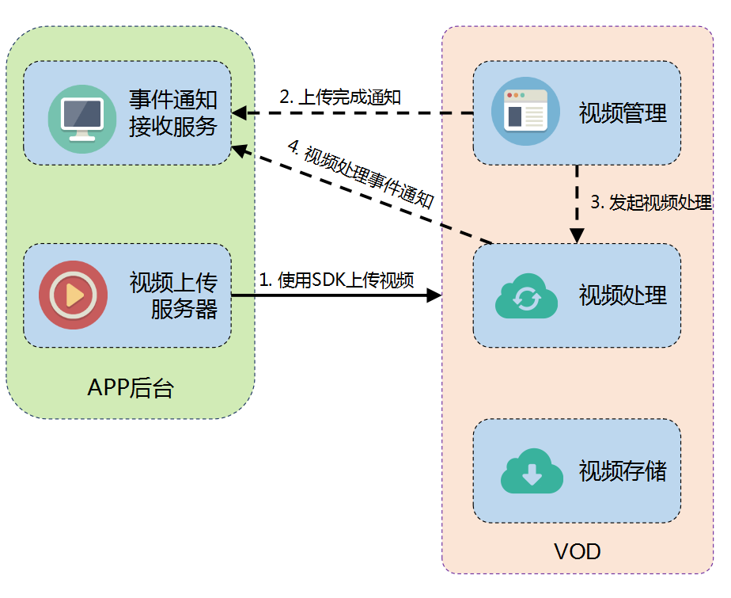
3.2 Tencent Cloud VOD solutions (continued)
Audio/Video storage - upload from server architecture:
Business scenarios: getting resources from multiple channels for unified upload and specifying storage region
Main features: API and SDK (recommended), event notification mechanism, and automatic video processing (task flow)
Architecture:
Notes:
如果云点播提供的上传 SDK 没有涵盖 App 后台所使用的语言，则 App 后台需要自行调用云点播的服务端 API 进行视频上传，相比 SDK 方式的上传，基于 API 方式的上传需要自行实现申请上传和上传文件等步骤。而上传文件也没有 SDK 的方式方便，对于大文件需要自己做分片上传等逻辑，这种上传方式是不推荐的文。
更多内容可参考文档链接：https://cloud.tencent.com/document/product/266/9759

Slide 33
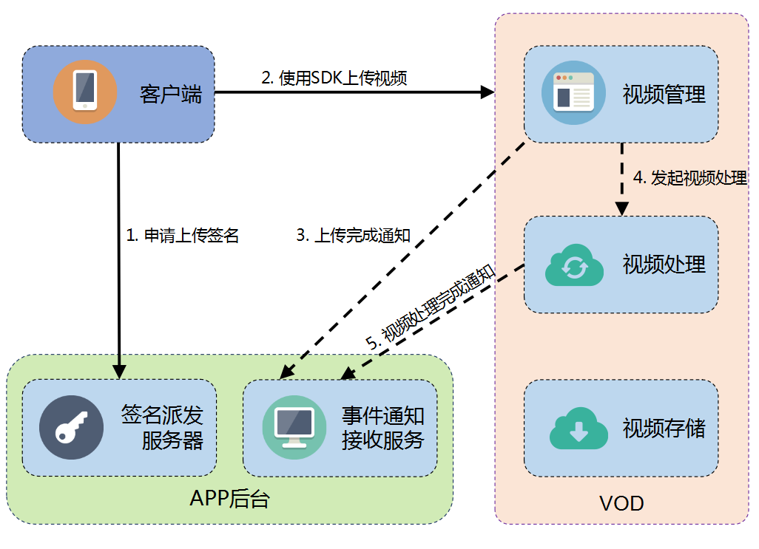
3.2 Tencent Cloud VOD solutions (continued)
Audio/Video storage - upload through client architecture:
Business scenarios: UGC
Main features: SDK for Android/iOS/web, event notification mechanism, automatic video processing (task flow), nearby upload, and checkpoint restart
Architecture:
Notes:
客户端视频上传是指 App 的最终用户将本地视频上传到云点播平台，流程架构如下：：https://cloud.tencent.com/document/product/266/9219
客户端需要向 App 的签名派发服务器申请上传签名，这是因为虽然客户端上传是直接将视频文件从客户端上传到云点播平台，无需 App 服务端中转，但云点播必须对发起请求的客户端进行鉴权，所以第一步是去APP后台的签名派发服务器去申请上传签名；
签名请求通过后，使用SDK进行视频上传，为了方便客户端的视频上传，云点播提供多平台 SDK 方便客户接入，比如Android上传SDK、IOS上传SDK、web上传SDK；
视频上传完成之后，云点播会给 App 后台发起 事件通知 - 视频上传完成，App 后台可通过该事件感知到视频上传行为。如果要接收事件通知，则 App 需要到 控制台 - 回调设置开启事件通知，这里当上传完成，则在云点播内部进行视频处理，同时视频处理完成也会将通知App后台视频处理完成的消息。

Slide 34
3.2 Tencent Cloud VOD solutions (continued)
Audio/Video storage - pull from URL:
Business scenarios: syncing resources from other cloud vendors/origin servers
Main features: event notification mechanism, automatic video processing (task flow), and MD5 check
Architecture:
Developer
1. Pull
VOD API
2. Download
Video origin server
4. Notification upon completion
3. Upload
Audio/Video storage
Notes:
By passing the video URL, the videos that already exist on the Internet, such as from other cloud vendors or origin sites, can be pulled to Tencent Cloud in batches, and multiple video files (up to 50) can be pulled in batches by entering the value of n in the parameter.

Slide 35
3.2 Tencent Cloud VOD solutions (continued)
Audio/Video processing - basic transcoding:
Supported formats: multiple input formats and HLS, MP4, FLV output formats
Parameter control: video bitrate/resolution/frame rate and audio bitrate/sample rate/sound channel
Watermark: static watermark (JPG or PNG) and dynamic watermark (APNG)
Animation: video to GIF and resolution/frame rate control
Editing: multi-video splicing and visual editing of video clips (coming soon)
Others: HLS Master Playlist, digital rights management (DRM), and independent transcoding mode
Notes:
Transcoding is the process of analyzing or processing the original video and outputting the processing results. You can refer to the document link：https://cloud.tencent.com/document/product/266/11701

Slide 36
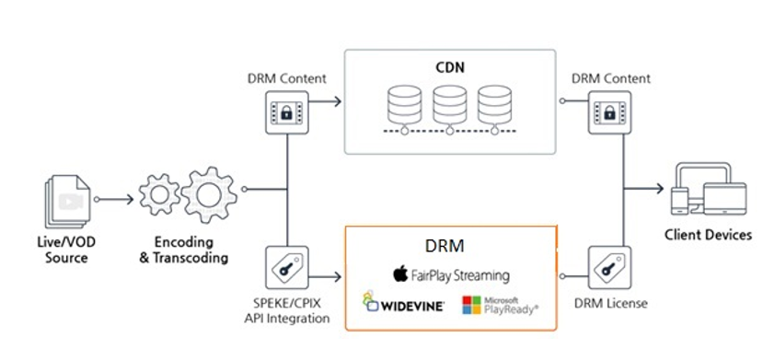
3.2 Tencent Cloud VOD solutions (continued)
Audio/Video processing - basic transcoding - DRM:
Business scenarios: protection against malicious distribution of copyrighted video and education industry
Main features: compliance with HLS standards and independent key for each encryption operation
Notes:
copyright protection, VOD offers a basic level of DRM (Digital Rights Management) solution, which uses HLS's AES encryption technology to encrypt video content. The encryption process is as follows：
First, the APP background initiates a video encryption request to the multimedia transcoding module;
The transcoding module obtains the encryption key from the key management service;
Encrypt and transcode the video source file uploaded by the user, and publish the encrypted video file to the CDN node;
The authentication and key distribution service module will also obtain the decrypted key from the key management service；
When the encryption is complete, the next step is the user's access logic：
The user logs in to the on-demand verification platform through the playback terminal and obtains the identity verification cookie;
The playback terminal obtains the playback address of the specified video;
Obtain the encrypted video according to the address;
The player will pass the obtained identity verification cookie to the authentication key distribution service to obtain the decryption key;
Use the decryption key to decrypt the encrypted video and watch it；
文档链接：https://cloud.tencent.com/document/product/266/9638

Slide 37
3.2 Tencent Cloud VOD solutions (continued)
Audio/Video processing - basic transcoding - COS+SCF+VOD:
Business scenarios: use of the transcoding service alone without storage and acceleration
Main features: direct read/write of users' COS resources (authorization required) and integration with SCF to automatically trigger transcoding
Standard VOD transcoding mode
Independent VOD transcoding mode
VOD API
VOD API
1. Request
4. Notification
Request
1. Request
4. Notification
Transcoding service
SCF
Transcoding service
2. Read
3. Write
Notification
2. Read
3. Write
Audio/Video storage
COS bucket
(input)
COS bucket
(output)
Notes:
Standard transcoding: the on-demand interface initiates a transcoding request, the transcoding service reads the video data from media storage, after the transcoding is successful, rewrites the transcoded video data into the storage, and then Return to the VDO API;
Independent transcoding mode: The VOD API initiates a transcoding request and triggers the SCF to read data from the object storage for transcoding. After the transcoding is successful, the data is rewritten into the object storage, and then the result is returned to the on-demand interface.

Slide 38
3.2 Tencent Cloud VOD solutions (continued)
Audio/Video processing - event notification mode:
Business scenarios: developer backend logic triggering by events
Main features: general mode (HTTP request) and reliable mode (message queue) that supports batch pull and batch confirmation
General mode example
Reliable mode example
Developer
Developer backend
Developer
Developer backend
1. Request transcoding
5. Send an event notification
(HTTP)
1. Request transcoding
5. Perform long polling
7. Return the event
VOD API
4. Send an event notification
Event notification
VOD API
2. Initiate transcoding
3. Complete transcoding
2. Initiate transcoding
3. Complete transcoding
4. Write into the queue
6. Read the queue
Transcoding
Transcoding
Message queue
Notes:
音视频处理的消息通知机制有普通模式和可靠模式两种：
普通模式就是由开发者向点播接口发起转码请求，转码模块进行转码，转码完成后将结果返回给点播接口，触发事件通知机制，返回给开发者后台；
可靠模式则采用消息队列异步的方式进行，开发者向点播接口发起转码请求，调用转码模块进行转码，转码完成后将消息返回给点播接口，消息并不会直接返回给开发者后台，而是将消息写入消息队列，开发者后台定期去点播接口发起轮询请求，点播接口向消息队列读取消息，将读取结果返回给开发者后台；
参考文档链接：https://cloud.tencent.com/document/product/266/7829

Slide 39
3.2 Tencent Cloud VOD solutions (continued)
Audio/Video processing - task flow:
Business scenarios: video processing according to fixed process
Main features: single request, automatic processing after video generation (upload, splicing, clipping, and pull), condition-based processing (customization required), and preset common templates
Built-in task flow example
Condition-based processing example
Video upload
Get the metadata
Get the metadata
Send an event notification
Is the bitrate greater than 1 Mbps?
No
Transcode
Perform sampled screencapturing
Generate an image sprite
Yes
Transcode
Store the audio/video
Unified callback
End
Notes:
音视频处理按照固定流程进行：
视频上传后，点播平台获取视频元数据信息，然后根据设置的判断条件有条件进行转码，比如以码率为判断依据，大于1Mbps进行转码，不足则不进行转码的动作，处理完后进行音视频存储，触发事件通知，返回结果。参考文档链接：https://cloud.tencent.com/document/product/266/11700

Slide 40
3.2 Tencent Cloud VOD solutions (continued)
Other scenarios: origin server migration
Business scenarios: migration from other clouds to Tencent Cloud and initial business launch
Main features: multiple migration modes (upload from server, pull from URL, and disk replication)
External hard disk
Developer origin server
other clouds
USB
Developer backend
CPM instance
SDK for upload from server
Public network/leased line (recommended)
Pull
Public network/leased line (recommended for origin server)
SDK for upload from server
Private network
URL list
VOD API
VOD API
VOD API
Audio/Video storage
Audio/Video storage
Audio/Video storage
Upload from server
Pull from URL
Disk replication
Notes:
云点播支持从开发者自己的源站或其他云厂商处拉取数据到云点播接口，也支持比如通过移动硬盘的方式将视频拷贝到黑石服务器中，然后通过腾讯云内网将数据上传至云点播服务的方式。

Slide 41
3.2 Tencent Cloud VOD solutions (continued)
Use case 1:
UGSV application:
Core requirements:
Quick upload and real-time distribution
Development of special effects and animated effects
Social media monetizing
Relevant services:
VOD, UGSV SDK, and beauty filter SDK
UGSV application scenario
Notes:
核心需求
To share content with others in real time requires Fast upload and real-time distribution.
Development of special effects and dynamic effects: shooting, beauty filters, dynamic effects pendants, special effects plug-ins, green screen keying, editing and other functions.
Monetization: By switching the short vdo with the mask emoji package and the original clip, the paid reward function is realized。

Slide 42
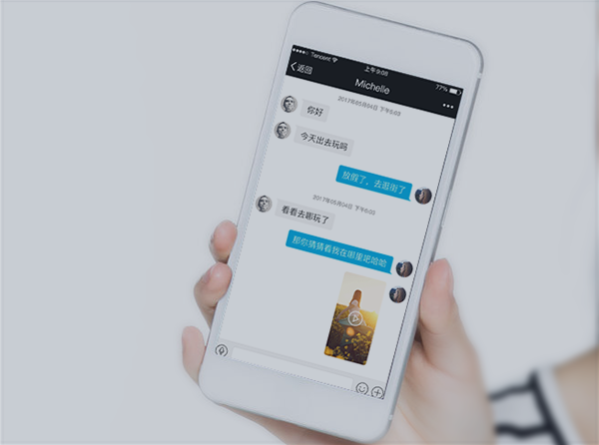
3.2 Tencent Cloud VOD solutions (continued)
Use case 2:
Interactive chat UGSV:
Core requirements:
Rich chat media
Improved immersive experience in interactive chat
Relevant services:
VOD, UGSV SDK, and IM
Interactive chat UGSV scenario
Notes:
核心需求
Enriching the medium of dialogue: adding short videos that follow the shots to the chat, breaking through the traditional way of chatting with pictures and texts.
Improve the real-life experience of interactive chat: real-time short videos can achieve more efficient and real interaction.

Slide 43
3.2 Tencent Cloud VOD solutions (continued)
Use case 3:
UGSV news:
Core requirements:
Quick capturing of news events
In-cloud editing of news content
Latest news video
Relevant services:
VOD and UGSV SDK
UGSV news
Notes:
核心需求
Shooting news content anytime and anywhere.
Cloud editing of news content: Smart editing and shared cloud storage allow users to see the news.
Intelligent scheduling realizes the nearby upload, fast distribution.

Slide 44
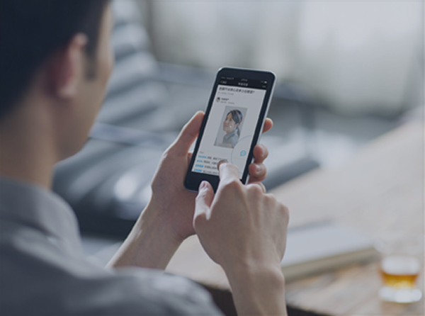
3.2 Tencent Cloud VOD solutions (continued)
Use case 4:
Q&A UGSV:
Core requirements:
Consulting efficiency and accuracy
Readability of Q&A content
Relevant services:
VOD, UGSV SDK, and IM
Q&A UGSV
Notes:
核心需求
Use short videos to show rich Q&A, suitable for professional consulting.
Increase the readability of Q&A content: Knowledge encyclopedia Q&A applications, through short videos and subtitles.

Slide 45
3.2 Tencent Cloud VOD solutions (continued)
Use case 5:
Gaming UGSV:
Core requirements:
Real-Time shooting and match updates
Live highlight recording
Gaming video production features
Relevant services:
VOD and UGSV SDK
Gaming UGSV
Notes:
核心需求
Shooting live competitions on-site, and sharing exciting and key links simultaneously.
Highlights of live stream interception records: smart editing, fast upload, and synchronization of the latest game status through short videos, which ignites public opinion on the event.
Game video production functions: set editing, filter special effects, music, subtitles, accelerated game clips and other functions.

Slide 46
Section 4. Scheme Design of RTC Scenario
4.1 Challenges faced by RTC scenarios
CONTENTS
4.2 Tencent Cloud TRTC solution
Notes:
本章节主要介绍视频行业的云架构方案：
直播场景方案设计
点播场景方案设计
实时音视频场景方案设计

Slide 47
4.1 Challenges faced by RTC scenarios
Challenges faced by RTC scenarios:
How do we achieve low latency in interactive RTC?
How do we guarantee the video smoothness during interaction?
How do we avoid echoes during video interaction?
How do we implement communication across countries/regions for the same service?
How do we deal with high-concurrency scenarios?
Notes:
We talked about it earlier in this chapter

Slide 48
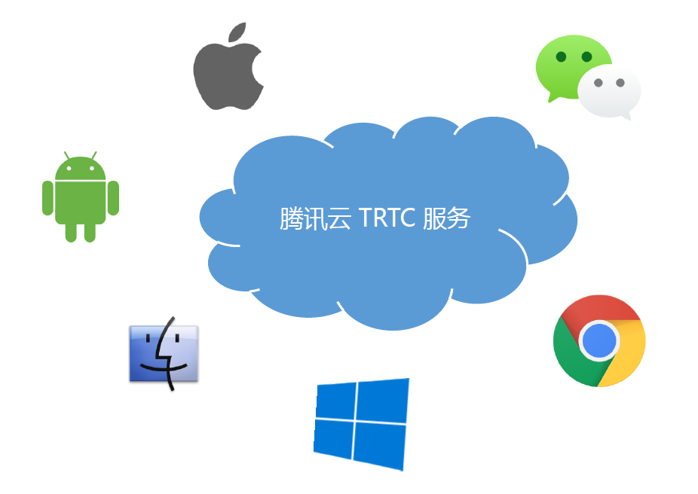
4.2 Tencent Cloud TRTC solution
Real-Time communication service:
Tencent Real-Time Communication (TRTC):
Developed by Tencent Cloud based on Tencent's over a decade of expertise in QQ audio/video chat technologies, TRTC provides cross-client, cross-platform, low-cost, high-quality, and customizable real-time communication services by leveraging the WebRTC capabilities of Tencent Browsing Service (TBS) and TRTC SDKs.
Support for mainstream platforms (including WeChat Mini Program)
HD image quality with a low latency of 500 ms
Better audio quality than that of traditional telephone lines
Support for connection to global lines
Notes:
产品优势：
低延时
Real-time audio and video TRTC provides high reliability, and secure network connection channels around the globe, using multiple optimization algorithms. When the terminal logs in overseas, the TRTC SDK will access the nearest acceleration point. Ensure that the end-to-end average delay of international link is <300ms。
低卡顿
Using intelligent network quality control and optimization to reduce the jam rate and jitter, Even in a weak network condition, high-quality audio and video communication can still be achieved。
高品质
Eliminates echo: CD sound quality, and supports ultra-high-definition picture (quality up to 1920 × 1080). Using Tencent Cloud video processing algorithm, with Tencent Browsing Service (TBS) kernel underlying compatibility support, optimize video clarity, reduce mosai。
全平台互通
业界真正实现全平台互通的解决方案，5000+终端完美适配。实时音视频支持在微信、手机 QQ、QQ 浏览器通过 H5 页面或微信小程序发起/接受/断开音视频通话，也支持直接在网页或通过 SDK 集成的方式在 PC、Mac 和 App 中实现音视频通话。

Slide 49
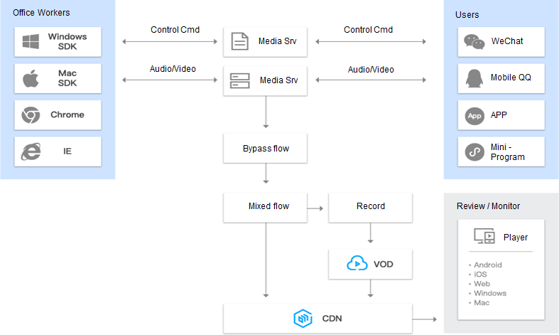
4.2 Tencent Cloud TRTC solution (continued)
Overall TRTC architecture:
Notes:
TRTC is a product that supports multi-terminal clients. Web and Mobile Apps
TRTC provides a Restful API. Developers can implement by using the SDK.
TRTC also supports a recording system. (Tencent VOD system is activated)

Slide 50
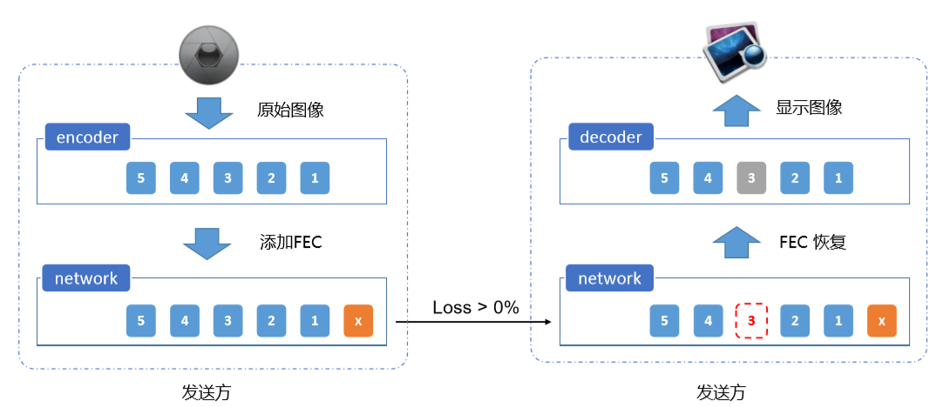
4.2 Tencent Cloud TRTC solution (continued)
TRTC - technical strengths:
FEC technology - prevents network packet losses
Sender
Recipient
Notes:
无线信道传输环境下，数字信号在传输的过程中往往由于各种原因，使得在传送的数据流中产生误码，使得接收端无法完全正常恢复发送端的原始数据，FEC的主要原理是通过对原始数据进行一定的算法处理，增加冗余内容，通过牺牲一定的传输带宽，来保证最后即使只接收到部分正常的数据和冗余内容，也能完整将原始数据恢复出来，被广泛的应用于数据存储和音视频传输领域等，如图所示：当发送方传输发送数据时，添加FEC基于整包数据帧进行冗余，当接收方收到数据后检测发现有数据帧丢包的问题，通过FEC进行恢复，最终保证数据的完整性。

Slide 51
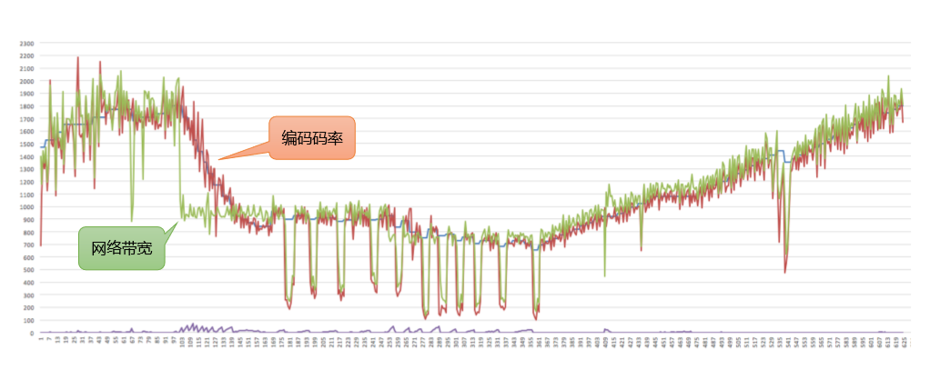
4.2 Tencent Cloud TRTC solution (continued)
TRTC - technical strengths:
QoS technology - responds to changes in available bandwidth
Notes:
Real-time audio and video have very high requirements for network quality.
Tencent’s real-time audio and video solutions introduce QoS service quality management technology, which has solved problems like network delay, jitter, and packet loss

Slide 52
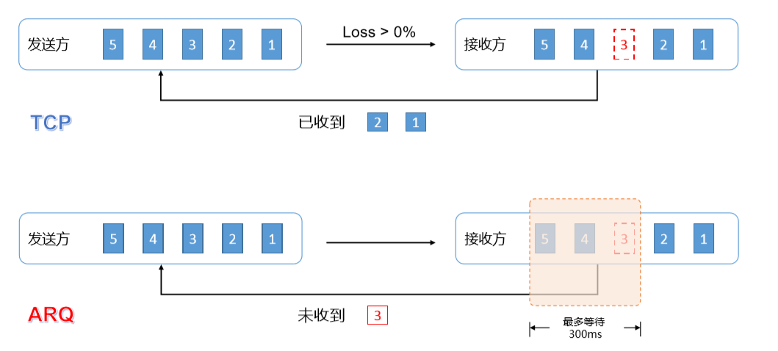
4.2 Tencent Cloud TRTC solution (continued)
TRTC - technical strengths:
ARQ technology - repairs network losses
Notes:
Automatic Repeat Request (ARQ) is one of the error correction protocols in the data link layer of the OSI model.
It includes stop waiting for ARQ protocol and continuous ARQ protocol, time-out retransmission. It contains mechanisms that solve the problem of data loss during network transmission, improving the stability of real-time audio and video.

Slide 53
4.2 Tencent Cloud TRTC solution (continued)
Use case:
Video customer service:
Core requirements:
Improvement in communication efficiency and customer service experience
Face-to-Face video consultation
Relevant services:
TRTC
Video customer service
Notes:
核心需求：
Improve communication efficiency and enhance customer service experience: Through video calls, users communicate with customer service face-to-face.
The demand for video face-to-face consultation:

Slide 54
4.2 Tencent Cloud TRTC solution (continued)
Use case:
Video police call:
Core requirements:
Police call visualization
Ease of use and promotion
Information security
Smart interaction
Relevant services:
TRTC
Video police call
Notes:
核心需求
Alarm visualization: the police communicate face-to-face.
Based on Tencent's cloud security capabilities, dedicated lines.
Intelligent interaction: The necessary information required by the police system is automatically synchronized, such as identity authentication, location information, etc

Slide 55
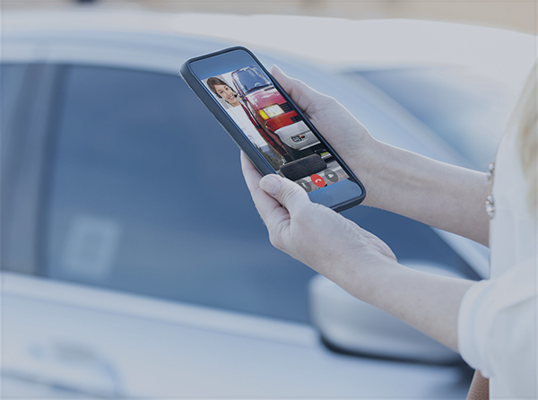
4.2 Tencent Cloud TRTC solution (continued)
Use case:
Auto insurance claim:
Core requirements:
Optimization of the offline auto insurance claim process
Claim process digitalization
Improvement in claim service experience
Relevant services:
TRTC
Auto insurance claim
Notes:
核心需求
Save claim settlement time, with a 3-step operation, and only take 5 minutes to complete the claim settlement.
The entire online claim process is recorded for future investigations.
Improve claims service experience
Operation costs are low, and claims can be completed by mobile app.

Slide 56
4.2 Tencent Cloud TRTC solution (continued)
Use case:
Interactive classroom:
Core requirements:
Enhanced teacher-student interaction
Immersive learning experience
Support for multiple clients and devices
Relevant services:
CSS
MLVB SDK
TRTC
VOD
Interactive classroom
Notes:
核心需求
Enhanced teacher-student interaction: sharing of blackboard writing and courseware.
Create a sense of on-the-spot teaching: live broadcast + multi-person connection, and real-time calls to create an immersive teaching experience.
Multi-terminal and multi-device coverage

Slide 57
Section 5. Video Industry Case Study
5.1 CSS case study
CONTENTS
5.2 VOD case study
5.3 TRTC case study
Notes:
Let’s look at some success cases in the video industry

Slide 58
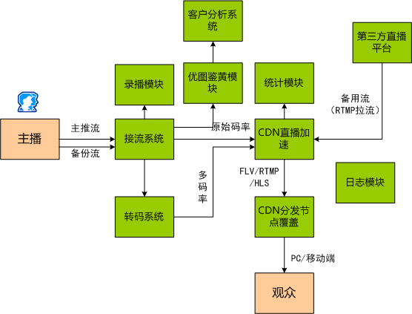
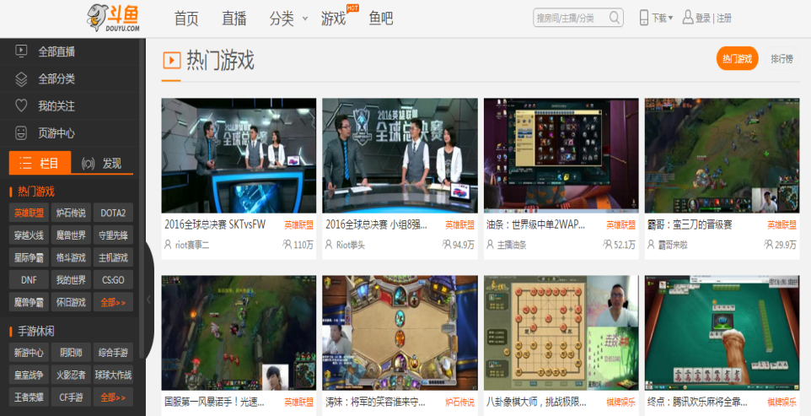
5.1 CSS Case Study
7,000+ live rooms
1 million concurrent online users
Live stream recording + playback
Real-Time porn detection for live streaming
Hundreds of millions of screenshots taken per month
CSS - Success Stories
DouYu live streaming system architecture
Technical architecture
Notes:
Business Needs：
Douyu TV urgently needs to improve the quality of live broadcasts and serve users with clearer, non-stutter-free live video core capabilities.
Other functions need to be improved, including system functions such as recording, screenshots, and photo identification, to achieve comprehensive live broadcast management.
The traditional live broadcast architecture has various problems such as difficulty in issuing and managing FLV/RTMP multi-protocol and inaccurate statistics.
Due to the particularity of the live broadcast business, customers are deeply troubled by pornographic video content。
Through in-depth communication, the Tencent Cloud team organized a detailed structure of the core business of Douyu's live broadcast：
The host side pushes two live streams to back up each other, providing a highly reliable live streaming solution.
Multi-rate transcoding is supported for live broadcast, which is convenient for customers to implement delivery schemes adapted to different playback scenarios, and greatly saves bandwidth costs.
Support RTMP/FLV protocol to return to the source from a third-party live broadcast platform to provide flexible live broadcast scheduling functions.
CDN live broadcast acceleration supports FLV (1 main line) and RTMP (3 alternate lines), with high-availability live streaming.
Provides a statistics module to support real-time online user information collection and statistics; the log module supports docking with the Douyu management platform to realize log push, which facilitates insight into business details through flexible log formats.

Slide 59
5.2 VOD Case Study
VOD - Success Stories
51yaoshi.com is an authoritative online learning website for licensed pharmacists under China Medical Science and Technology Press.
Relying on the resources of the China Food and Drug Administration and China Medical Science and Technology Press, it provides users with more exclusive resource services and more profound policy interpretations.
NewTV is a subsidiary of China Network Television (CNTV).
On March 24, 2010, CNTV was the first to receive an internet TV license from the National Radio and Television Administration.
NewTV currently provides over 1.5 million hours of quality on-demand programs to users and has exclusive internet TV rights to broadcast the Olympic Games, the World Cup, and the European Cup.
Souzhiyun is the first Chinese online education public service platform provider that integrates live streaming and VOD, R&D and operations, and mobile internet and internet.
It provides services such as live streaming teaching, online assessment, online test, and community-based learning services for many educational and training institutions nationwide.
The Souzhiyun platform has built comprehensive strategic partnership with hundreds of universities, thousands of training institutions, ecommerce operators, major banks, mobile network carriers, etc. in China and integrates over 300 popular professional courses in 20 major industries in the education and training sector.

Slide 60
5.3 TRTC Case Study
TRTC - Success Stories

Slide 61
Course summary
This course covers:
Characteristics of different types of video industry scenarios
Video service architecture design
Typical use cases in the video industry

